Slide 1

Meeting of Working Group 3L-1
WG 3L-1 - MF & LF
(Geneva, 5 September 2014)
(Opening at 09:00 hours on 5 September 2014)
(Room T 101, Tower Building)
Ângelo Canavitsas
canavitsas@openlink.com.br

Slide 2
Draft agenda for the meeting of Working Group 3L-1
1 Opening remarks
2 Approval of the agenda
3 Document 3L/88-E - United Kingdom of Great Britain and Northern Ireland - Proposed revision of Recommendation ITU-R P.1147-4
4 Document 3L/91-E - Russian Federation - Proposed revision of Recommendation ITU-R P.1321
5 Document 3L/92-E - Japan - Activity Report - An evaluation of the numerical prediction method of field strength for long-range propagation of LF radio waves base on a wave-hop propagation theory
6 Revision 1 to Document 3L/95-E - Brazil (Federative Republic of) - Proposed revision to Recommendation ITU-R P.832-3 World atlas of ground conductivities
7 Document 3L/96-E - Germany (Federal Republic of) - Proposed revision of Recommendation ITU-R P.832-3
8 Any other business
9 Conclusion

Slide 3
Proposed revision of Recommendation ITU-R P.1147-4
Document 3L/88-E - United Kingdom of Great Britain and Northern Ireland - Proposed revision of Recommendation ITU-R P.1147-4

Slide 4
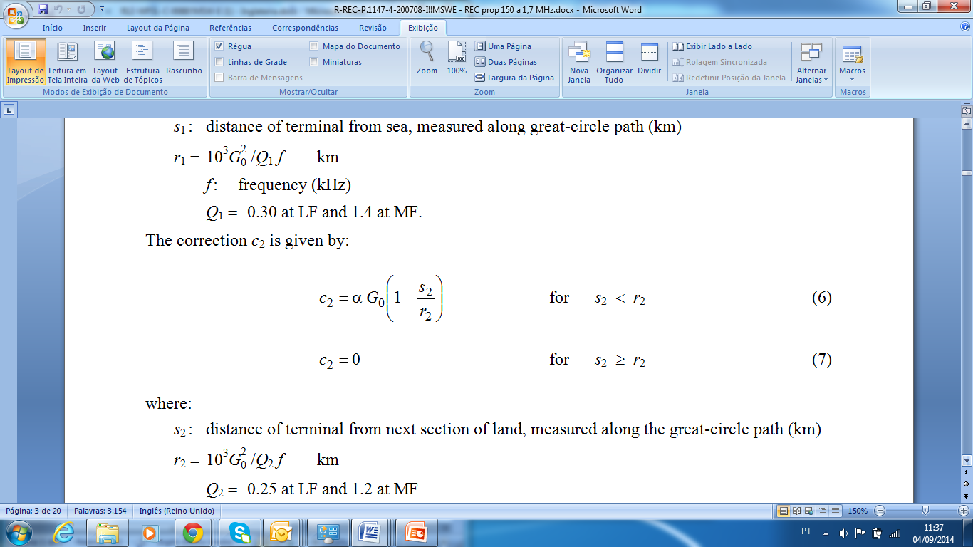

Slide 5
Proposed revision of Recommendation ITU-R P.1321
Document 3L/91-E - Russian Federation - Proposed revision of Recommendation ITU-R P.1321

Slide 6
Proposed text to be inserted at the end of section “4.1.1 Seasonal variations”
For MF at average latitudes with a continental climate with a significant density of wooded areas, the range of seasonal changes in variation of the field strength of ground waves on links approximately up to 100 km is located on average within the limits of 10-18 dB. Thus the smaller sizes are related to lines beginning inside a large city (10 dB) or running above a city (up to 15 dB). The greatest range has the lines which are not touching a city (15-18 dB). Similar results it is possible to expect and in other regions with similar climatic and natural conditions.

Slide 7
Numerical prediction method of field strength for long-range propagation of LF
Document 3L/92-E - Japan - Activity Report - An evaluation of the numerical prediction method of field strength for long-range propagation of LF radio waves base on a wave-hop propagation theory

Slide 8
Proposed revision to Recommendation ITU-R P.832-3 World atlas of ground conductivities
Revision 1 to Document 3L/95-E - Brazil (Federative Republic of) - Proposed revision to Recommendation ITU-R P.832-3 World atlas of ground conductivities

Slide 10
Methodology to perform measurements to survey the ground conductivity
The Administration of Brazil is going to continue conducting field measurements to survey the ground conductivity. The work will include experts from various scientific areas and the results will further enhance the conductivity map, leaving it with more resolution and accurate information.
Sketched representation of layers affecting ground electrical conductivity

Slide 11
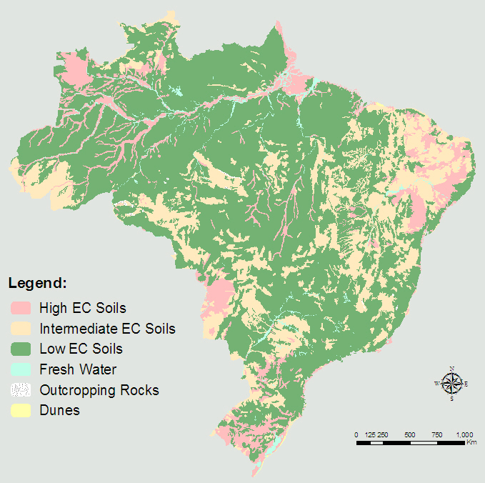
Methodology to perform measurements to survey the ground conductivity

Slide 12
Proposed revision of Recommendation ITU-R P.832-3
Document 3L/96-E - Germany (Federal Republic of) - Proposed revision of Recommendation ITU-R P.832-3

Slide 13
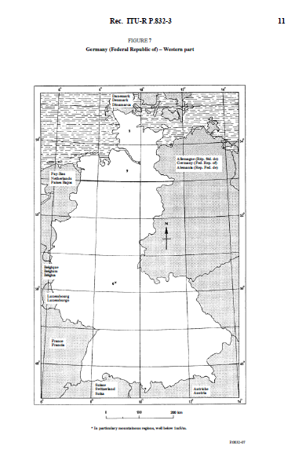
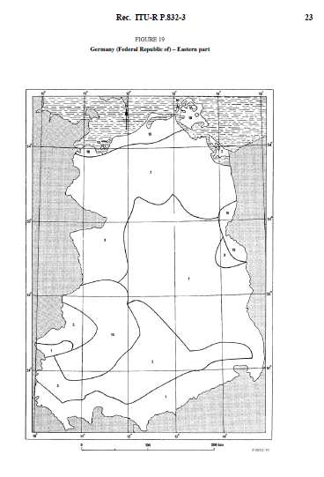
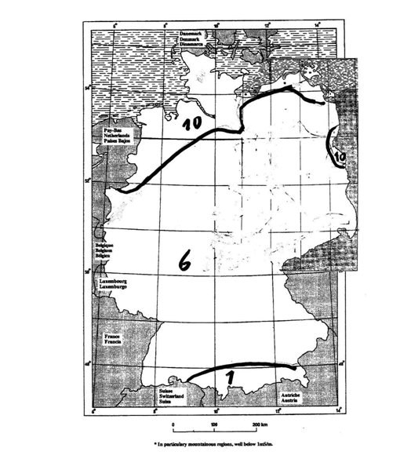

Slide 14
Any other business
Conclusion
Ângelo Canavitsas
  E-mail: canavitsas@openlink.com.br

